Slide 1
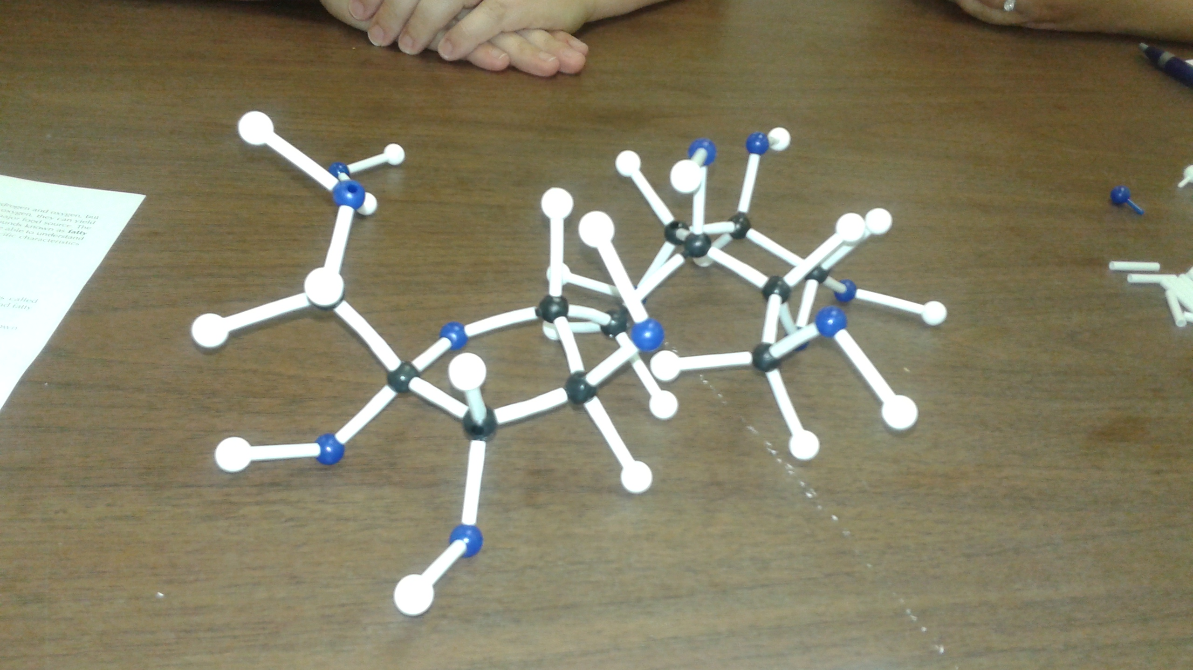
Mrs. P. Williams’ Pre-AP Biology Class

Slide 2
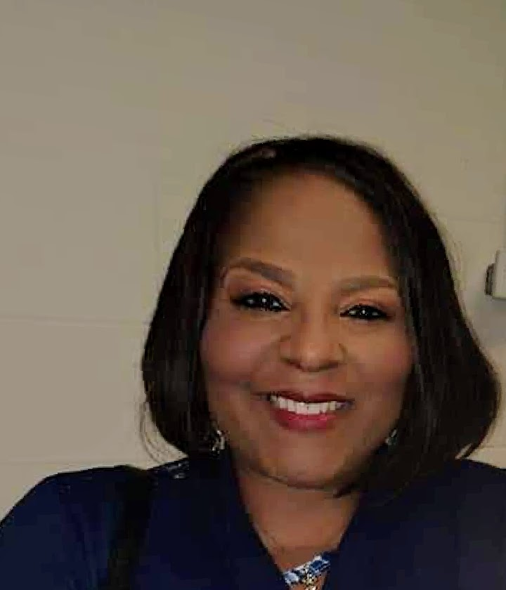
ABOUT ME
(Must include picture AND video)
Family- I have been married for over 20 years to my awesome husband and we four children, and several grandchildren. I am originally from Alabama.
Education- I have a Master degree from Alabama A&M University in Education. I have been biologically trained at the University of Alabama-Birmingham Alabama, and the University of Kentucky, in the areas of Biotechnology, and Principles of Biomed
Hobbies- I absolutely love sustaining ecosystems, baking, productively thinking, and researching interesting phenomena. Most importantly, I love instructing.

Slide 3
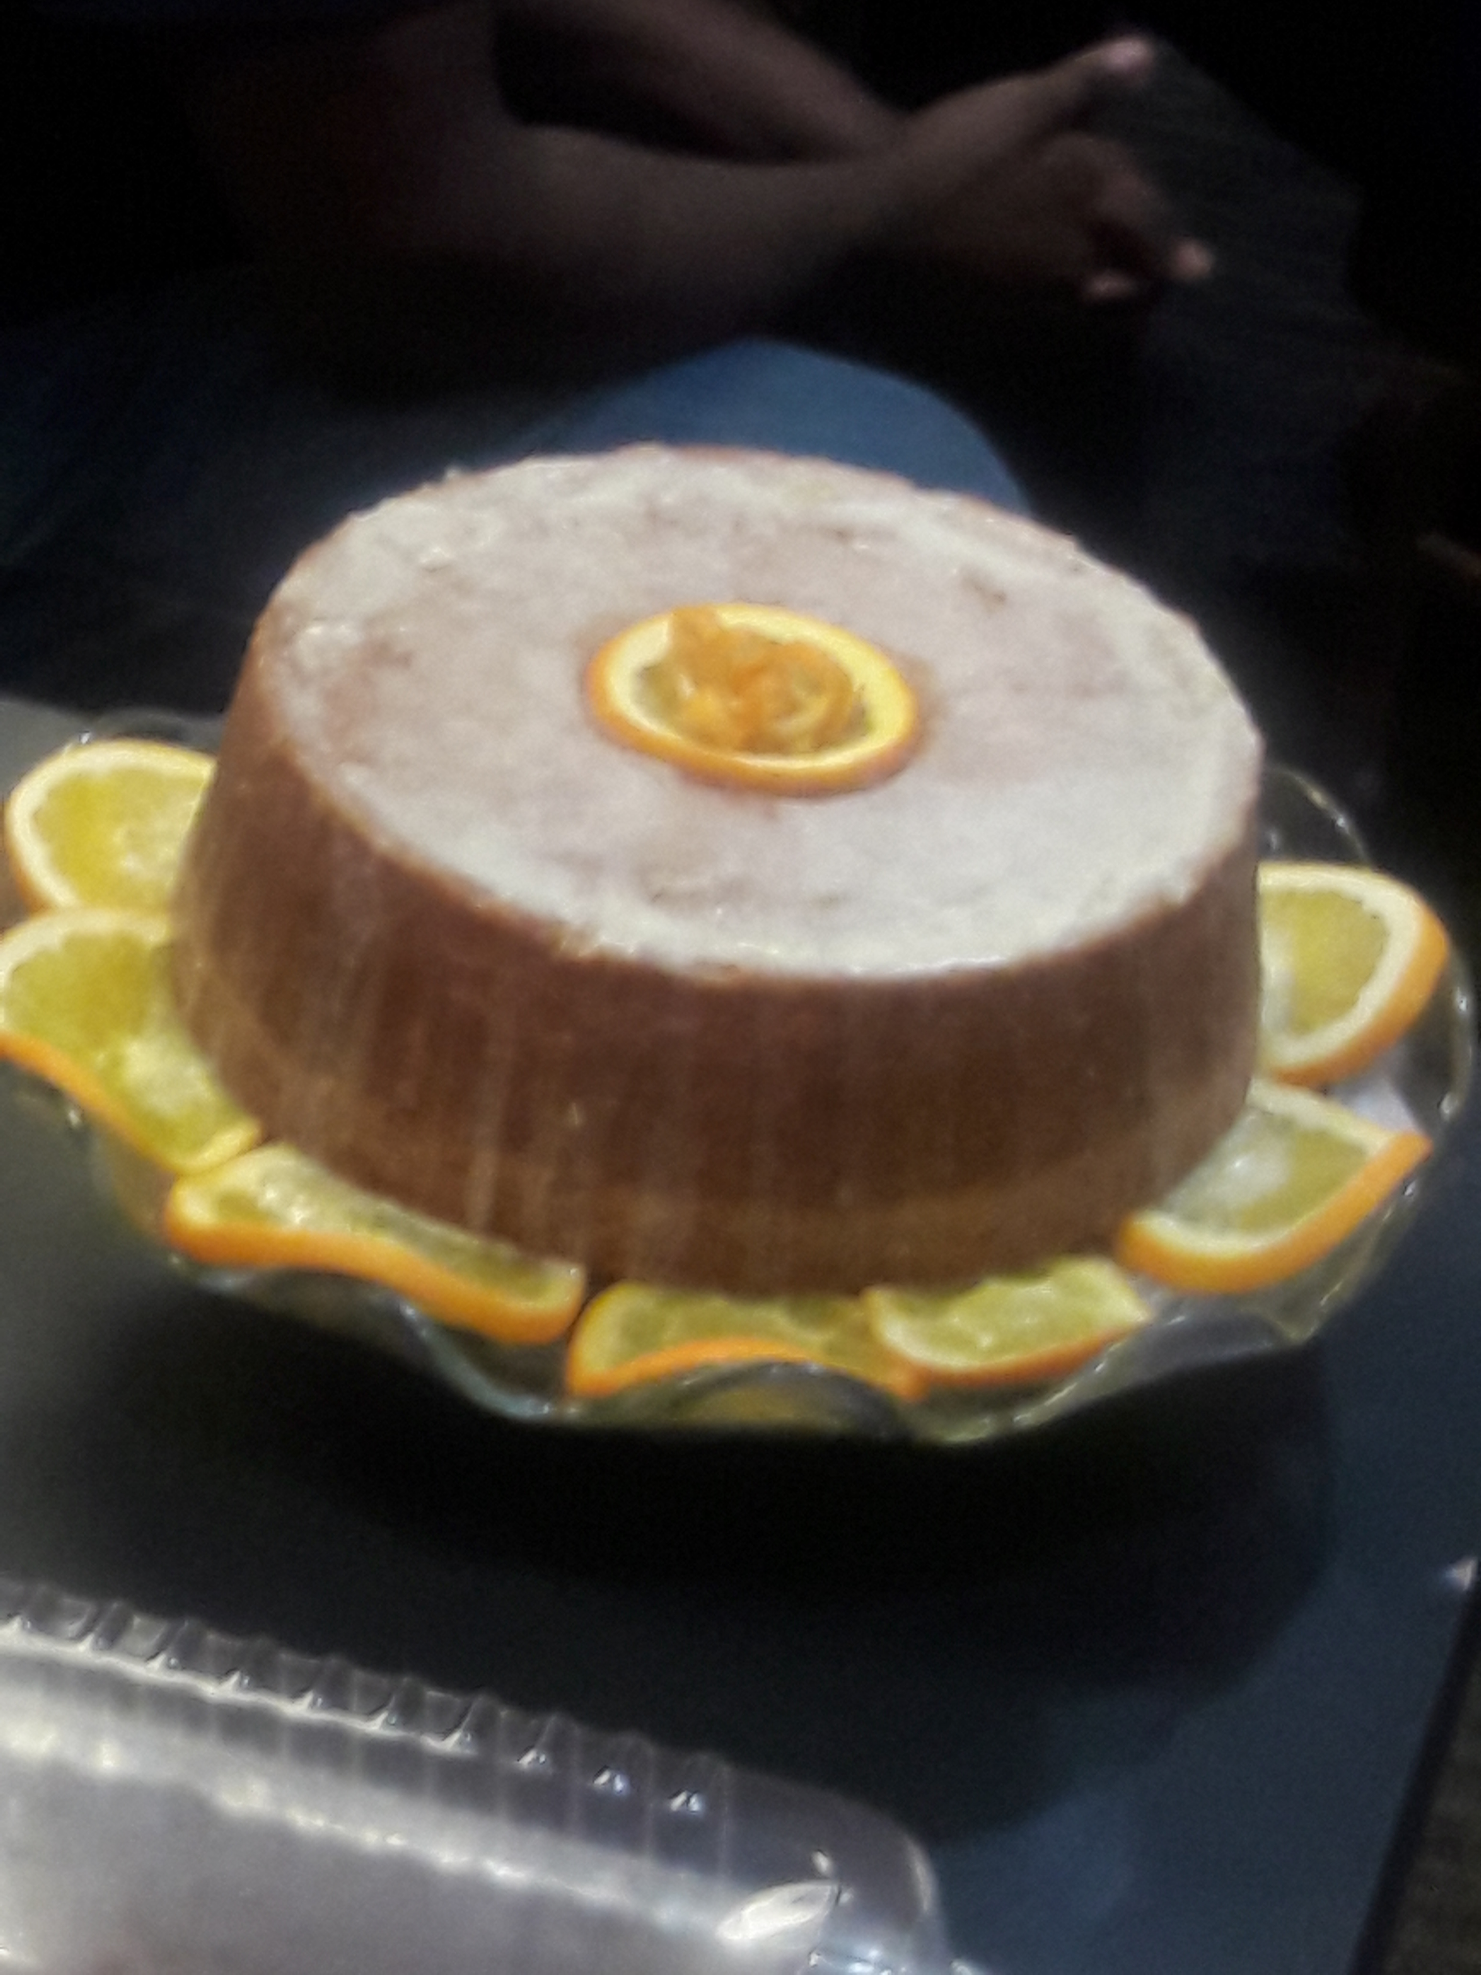
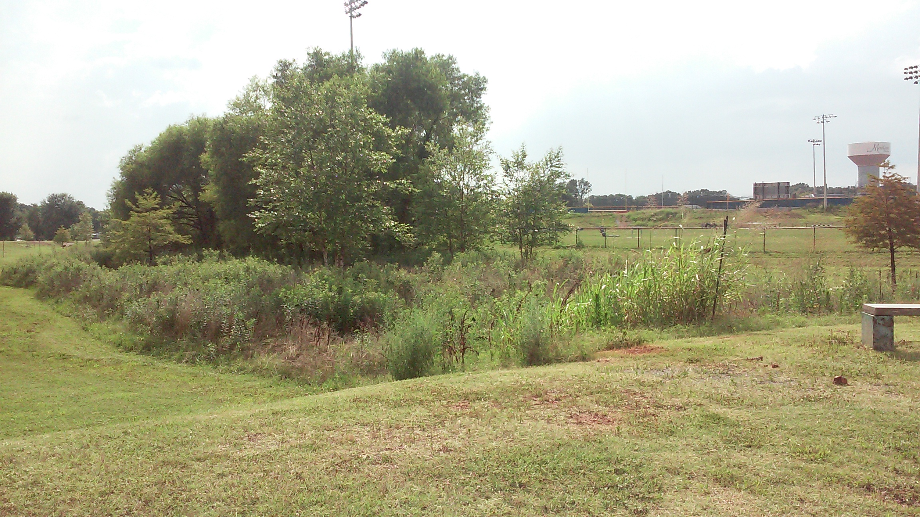
Hobby Pictures
My Citrus Pound Cake
Sustaining Ecosystems: Before and After Pictures

Slide 4
SCHEDULE
FALL | SPRING
Pre-AP Biology | Pre-AP Biology
Pre-AP Biology | Pre-AP Biology
Career Prep | Pre-AP Biology

Slide 5
CONTACT INFORMATION
EMAIL: pwilliams@madisoncity.k12.al.us
PHONE: (256) 216-5313 Ext. 95215

Slide 6
Imperative Information
Personal mission statement:
I plan to instill that you can achieve learning Pre-AP Biology in a rich culture of learning as long as your are accountable, engaged, and you are responsible for doing your part thoroughly.
Goal This Year: I am a Confident and Self-Reflective Learner because I am Original, Innovative, and Productive!!!!!!!!!!!
Complaining: As you have transitioned from eighth grade to high school, this learning curve can be challenging, but there is a work-around. We will work together! No complaining as we work to find solutions to problems.
Favorite quote: One minute lost can never be regained- Kathryn Lang

Slide 7
Virtual Learning Expectations
1. Time Management-Be on time and in a quiet place. Log on before each class starts.
2. Virtual Location-Find a quiet and suitable place like a table or desk.
3. Be Prepared- Make sure that your computer is charged and camera is on. Use headphones if you have them.
4. Presentations- Wear appropriate clothing. Sit straight up and be in camera view.
5. Mute Yourself- Specifically when the instructor or other classmates are speaking.
6. Participation-Be focused and attentive.
7. Chatting- Raise your hand to speak. Type questions in the chat.
8. Communications- Speak clearly and with volume. Look up when speaking.
9. Jet Core Values: Jets are respectful, resourceful, and responsible.

